Slide 1
Chapter Three
Data Encoding, Data Transmission and Multiplexing

Slide 2
Introduction
Data transmission occurs between transmitter and receiver over some transmission medium
Transmission media may be classified as guided or unguided
  In both cases communication is in the form of electromagnetic waves
The successful transmission of data depends on
  the quality of the signal being transmitted
  the characteristics of the transmission medium

Slide 3
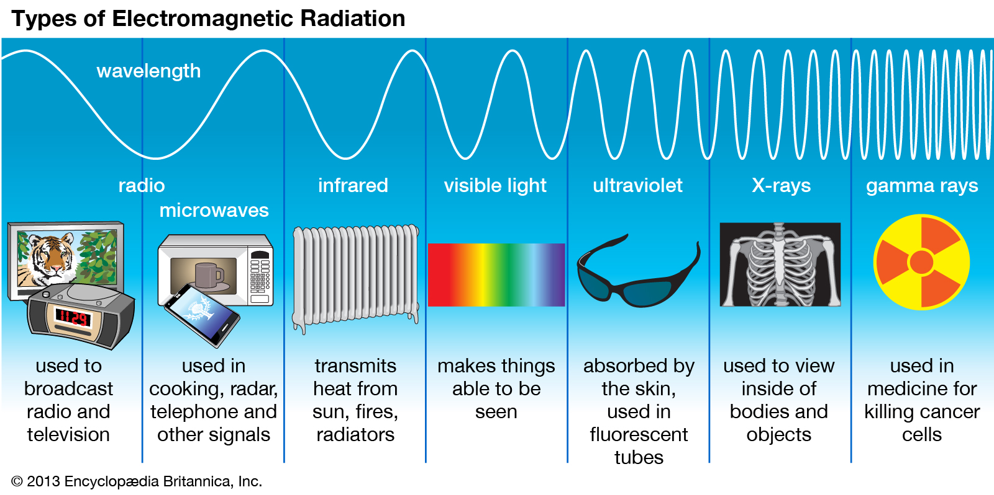

Slide 4
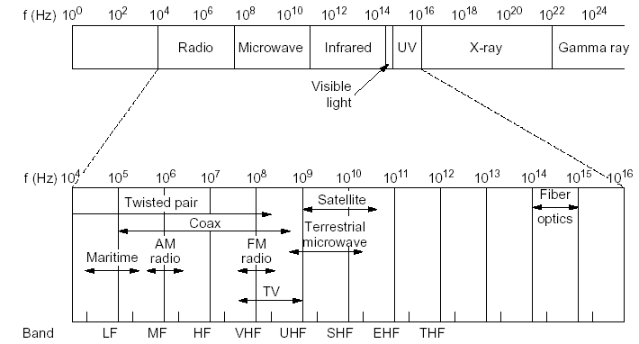

Slide 5
Analog and Digital Data Transmission
In transmitting data from a source to a destination:
  the nature of the data
  the transmission media used to propagate the data
  what processing or adjustments may be required along the way to assure that the received data are understandable
The term analog and digital correspond, roughly to continuous and discrete respectively

Slide 6
Data
  Entities that convey meaning
  Can be
    analog
      data take on continuous values on some interval, i.e. continuously varying patterns of intensity
      E.g. Audio, video, temperature, etc
    digital
      data take on discrete values
      E.g. text or character strings

Slide 7
Signals
  Electric or electromagnetic representations of data
  Can be also digital or analog
  analog signal
    is a continuously varying electromagnetic wave that may be propagated over a variety of media
    Three important characteristics: Amplitude, Frequency, Phase
    Frequency Spectrum of a signal:
      is the collection of all component frequency
    Bandwidth of a signal
      is the range of component frequencies or the width of the frequency spectrum

Slide 8
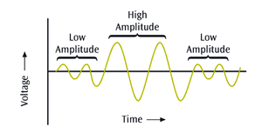
Amplitude
  The vertical distance between the highest pick (crest) and the wave’s central axis
  measured in volts, amperes, or watts

Slide 9
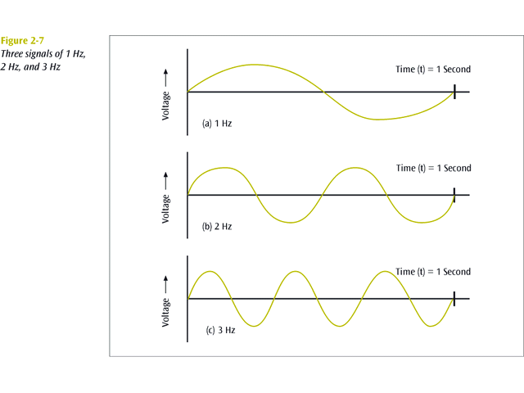
Frequency
  The number of periods in one second
  Period – the amount of time, in seconds, a signal needs to complete one cycle
  Period and frequency have inverse relationship
  Measured in Hertz (Hz.)

Slide 10
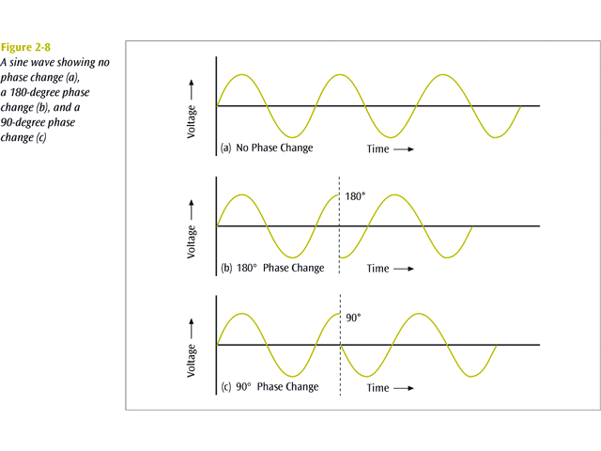
Phase
  The position of the waveform relative to time zero
  Measured in degrees or radians

Slide 11
A digital signal is a sequence of voltage pulses that may be transmitted over a wire medium
  Bit Interval : the time required to send a single bit
  Bit rate : the number of bit intervals per second usually expressed in bits per second (bps)
Signaling is the physical propagation of the signal along a suitable medium

Slide 12
Transmission
  Communication of data by propagation and processing of signals
  The way signals are treated is a function of the transmission system
  Analog transmission is a means of transmitting analog signals without regard to their content the signals may represent analog data (e.g., voice) or digital data (e.g., binary data that pass through a modem).
  Digital transmission, in contrast, is concerned with the content of the signal.

Slide 13
Which is the preferred method of transmission?
  Digital transmission is preferable
The reasons are
  Digital technology are:
    Continuing to drop in cost and size
    Analog equipment has not shown a similar drop
  Data integrity
    With the use of repeaters the effect of noise and other signal impairments are not cumulative
  Capacity utilization
    High degree of multiplexing
  Security and privacy
    Encryption techniques can be readily applied to digital data and to analog data that have been digitized
  Integration
    Can treat analog and digital data similarly

Slide 14
Signal vs. data
Analog signals can represent analog and digital data and digital signals can represent digital as well as analog data
Analog data are a function of time and occupy a limited frequency spectrum
  Such data can be represented by an electromagnetic signal occupying the same spectrum
Digital data can be represented by digital signals
  Different voltage level for each of the two binary digits is used
Digital data can also be represented by analog signals
  Using modem
Analog data can be represented by digital signals
  Using codec

Slide 15
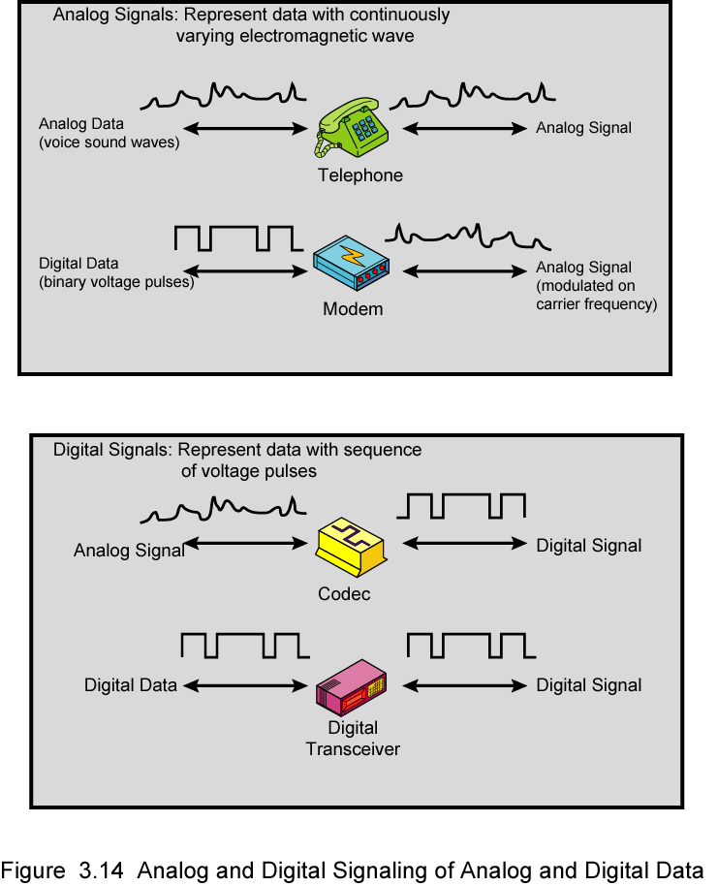
Analog Signals Carrying Analog and Digital Data

Slide 16
Digital Signals Carrying Analog and Digital Data
Data

Slide 17
Encoding and Modulation Techniques
Encoding:
  the process of preparing data for efficient and accurate transmission
Modulation:
  the process of encoding a baseband source signal onto a carrier signal
Four combinations
  Digital data, digital signal
  Analog data, digital signal
  Digital data, analog signal
  Analog data, analog signal

Slide 18
Digital Data, Digital Signal
A digital signal is a sequence of discrete, discontinuous voltage pulses
Each pulse is a signal element.
Binary data are transmitted by encoding each data bit into signal elements
  E.g. binary 0 is represented by -5V and binary 1 by +5V
At the receiving end the receiver:
  must know the timing of each bit. That is, the receiver must know with some accuracy when a bit begins and ends
  must determine whether the signal level for each bit position is high (1) or low (0)

Slide 19
Success factors:
  the signal-to-noise ratio
  the data rate - is closer to bandwidth, but it is often per host, or source to destination devices.
  the bandwidth - is the number of bits per second that a link can send or receive, including all flows.
The encoding scheme that can be used can also improve performance
Encoding schemes
  Non-return to Zero (NRZ)
    NRZ-L
    NRZ-I
  Biphase
    Manchester
    Differential Manchester

Slide 20
NRZ
  Uses two different voltage levels (one positive and one negative) as the signal elements for the two binary digits
    For Example: Absence of voltage for zero, constant positive voltage for one
  More often, negative voltage for one value and positive for the other
  Two Variants
    NRZ-L
    NRZ-I

Slide 21
NRZ-L
  Digital 1s are represented as one voltage (amplitude), while digital 0s are represented as another:
    Cheap to implement
    Check for voltage of each bit
    A long series of 1s or 0s produces a flat, unchanging voltage level (produces synchronization problems)
NRZ-I
  Digital 1s are represented by a voltage change (high-to-low, or low-to-high), while 0s are represented as a continuation of the same voltage level:
    1 ⬄ existence of a signal transition at the beginning of the bit time (either a low-to-high or a high-to-low transition)
    0 ⬄ no signal transition at the beginning of the bit time
  Even cheaper to implement (only check for changes)
  A long series of 0s produces a flat, unchanging voltage level

Slide 22
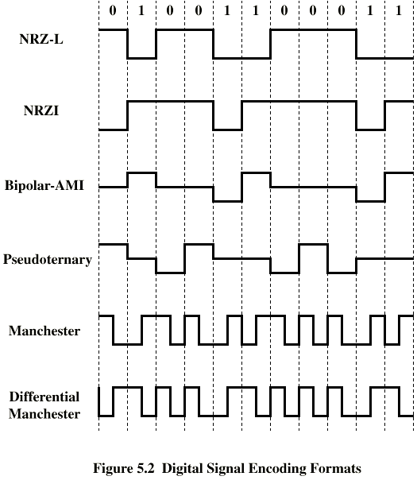

Slide 23
Pros and Cons of NRZ
  Pros
    Easy to engineer
    Make good use of bandwidth
  Cons
    Lack of synchronization capability
  Used for magnetic recording
  Not often used for signal transmission

Slide 24
Biphase
Manchester
  Transition in middle of each bit period
  Transition serves as clocking
  Low to high represents one
  High to low represents zero
  Used by IEEE 802.3
    Used in 802.3 baseband coaxial cable and CSMA/CD twisted pair.
Differential Manchester
  Midbit transition is clocking only
  Transition at start of a bit period represents zero
  No transition at start of a bit period represents one
  Note: this is a differential encoding scheme
  Used by IEEE 802.5
  Used in 802.5 (token ring) with twisted pair.

Slide 25
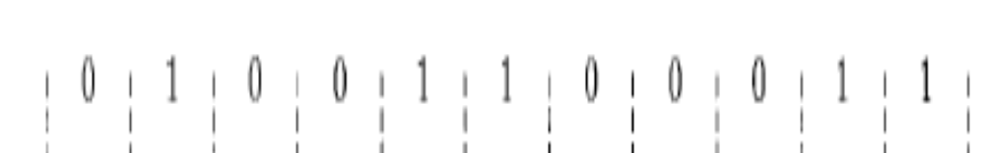
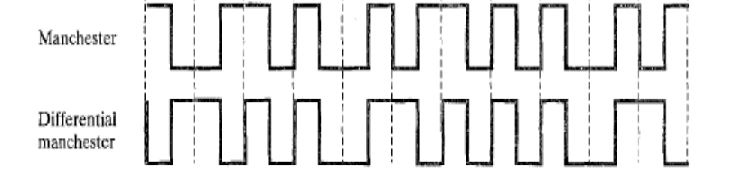

Slide 26
Digital Data, Analog Signals
The most familiar use of this transformation is for transmitting digital data through the public telephone network using modem
Basis for analog signaling is a continuous, constant-frequency signal known as the carrier frequency.
Digital data is encoded by modulating one of the three characteristics of the carrier: amplitude, frequency, or phase or some combination of these.
there are three basic encoding or modulation techniques
  Amplitude-shift keying (ASK)
  Frequency-shift keying (FSK)
  Phase-shift keying (PSK)

Slide 27
ASK
  Is the modulation method where digital signals change the amplitude of the carrier wave
  the two binary values are represented by two different amplitudes of the carrier wave
    If the digital signal value is 1, the amplitude of the carrier wave remain the same
    When the digital signal value is 0, the amplitude of the carrier wave is much weaker or zero.
  Used in our infrared remote controls
  Used in fiber optical transmitter and receiver.

Slide 28
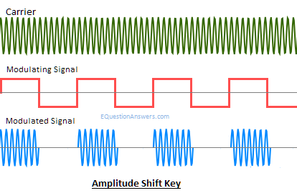

Slide 29
FSK
  Is the digital modulation technique in which the frequency of the carrier wave changes with digital signals
  the two binary values are represented by two different frequencies near the carrier frequency
    When the value is 1 the frequency of the carrier wave is higher and lower when the value is 0.
  Many modems used FSK in telemetry systems

Slide 30
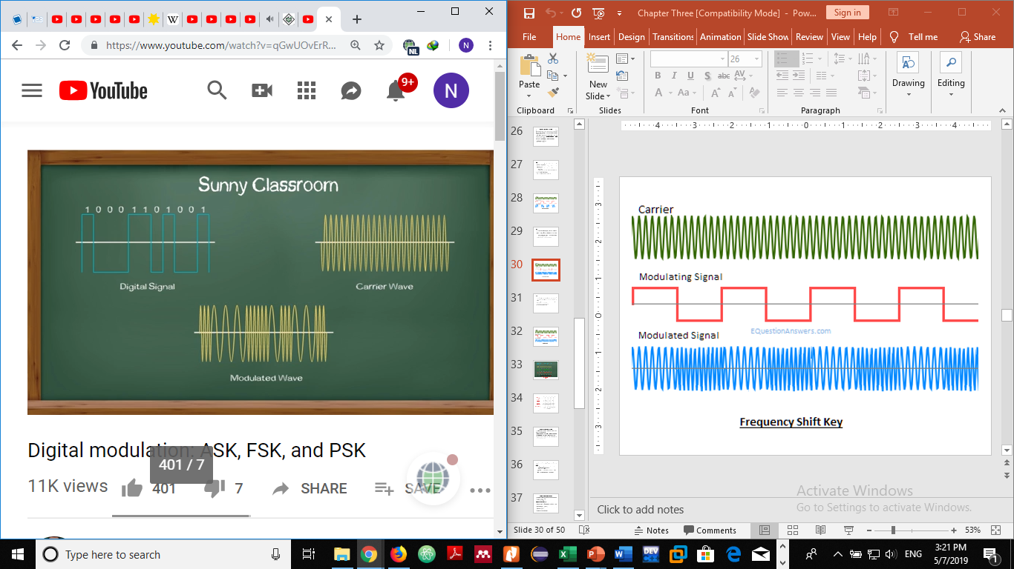

Slide 31
PSK
  Is a digital modulation technique which transmits data by changing the phase of a constant frequency of the carrier wave
  The frequency and amplitude of the carrier wave remain the same.
  Phase changes at the point where binary value 1 changes to binary value 0 or 0 changes to 1.
  Used in our ADSL broadband modem
  Used in satellite communication
  Used in our mobile phones

Slide 32
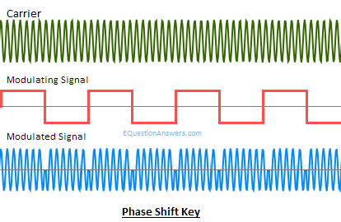

Slide 33
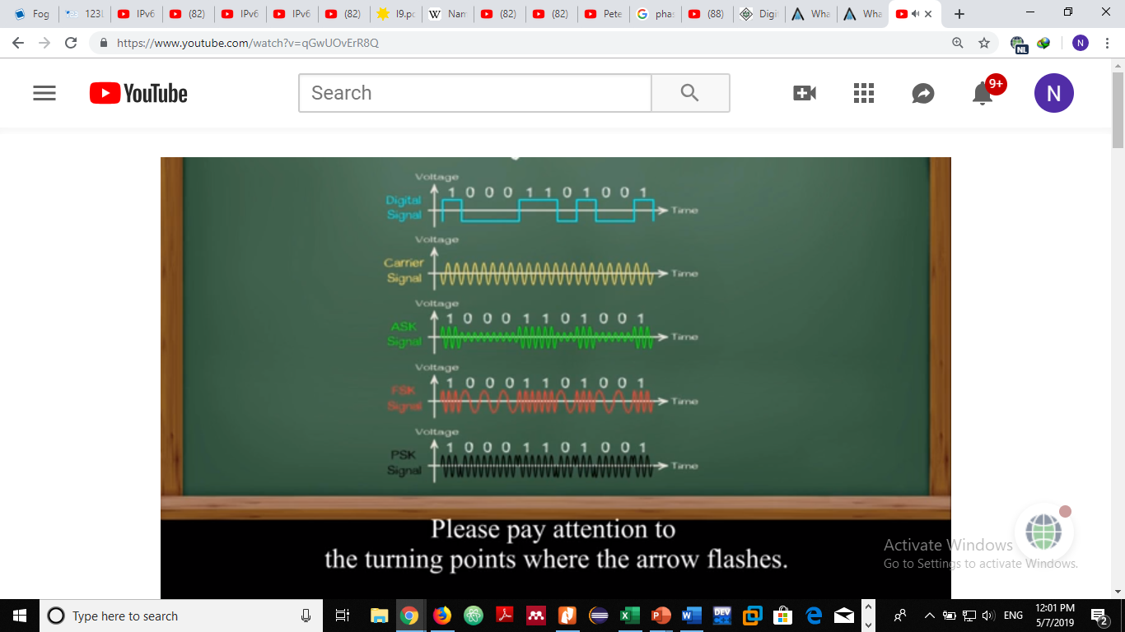

Slide 34
Analog Data, Digital Signals
To send continuous data such as voice information over a digital transmission medium
  Example: To transfer analog voice signals off a local loop to digital end office within the phone system, one uses a codec
The most common technique for using digital signals to encode analog data is PCM

Slide 35
PCM is a method used to digitally represent sampled analog signals
Steps
  Sampling - sample the continuous data - to measure the value of the continuous data at equal interval
    Each sample is called Pulse
  Quantization - the resulting pulse is quantized - assigned a value
  Coding - each value is transformed to binary number

Slide 36
Analog Data, Analog Signal
The principal techniques for modulation using analog data are:
  amplitude modulation (AM)
  frequency modulation (FM)
  phase modulation (PM)
Amplitude Modulation (AM)
  is the process of varying the instantaneous amplitude of carrier signal accordingly with instantaneous amplitude of message signal.
  is the simplest type of modulation.
  Hardware design of both transmitter and receiver is very simple and less cost effective.
  is very susceptible to noise.
  AM radio broadcast is an example

Slide 37
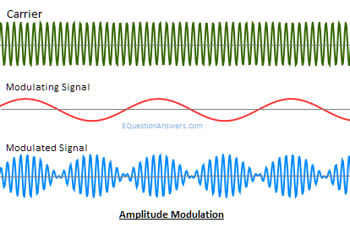

Slide 38
Frequency Modulation (FM)
  is the process of varying the instantaneous frequency of Carrier signal accordingly with instantaneous amplitude of message signal.
  Modulation and demodulation does not catch any channel noise.
  Circuit needed for FM modulation and demodulation is a bit complicated than AM.
  FM radio broadcast is an example

Slide 39
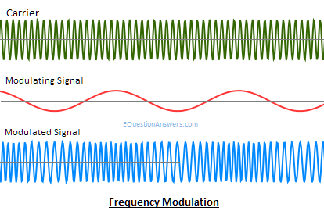

Slide 40
Phase Modulation
  is the process of varying the instantaneous phase of Carrier signal accordingly with instantaneous amplitude of message signal.
  Modulation and demodulation does not catch any channel noise.
  Circuit needed for PM modulation and demodulation is a bit complicated than AM and FM.
  Satellite communication.

Slide 41
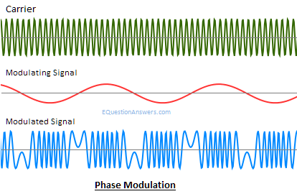

Slide 42
Transmission Impairments
Signal received may differ from signal transmitted
Analog - degradation of signal quality
Digital - bit errors
  A binary 1 is transformed into a binary 0 and vice versa
Caused by
  Attenuation and attenuation distortion
  Distortion
  Noise
Solution
  Amplifiers – analog signal
  Repeaters – digital signal

Slide 43
Attenuation
  It is a phenomenon which occurs when signal strength falls off with distance
  It depends on medium
    mediums such as Fiber optic cables carries signal without attenuation up to 2Km.
  In communicating entities, received signal strength:
    must be enough to be detected
    must be sufficiently higher than noise to be received without error

Slide 44
Noise
  Additional signals inserted between transmitter and receiver is known as noise
  Noises can be caused by
    Thermal
      Due to thermal agitation of electrons
    Crosstalk
      A signal from one line is picked up by another
    Impulse Noise
      is sharp quick spikes on the signal caused from electromagnetic interference, lightning, sudden power switching, electromechanical switching, etc.

Slide 45
Distortion
  The signal changes its form or shape
  Can occur in a composite signal made of different frequencies
  Each signal component has its own propagation speed through a medium and therefore, its own delay in arriving at the destination
  Differences in delay may create a difference in phase
  The shape of the composite signal is therefore not the same
Intermodulation noise
  When signals at different frequencies share the same transmission medium
    They produce signals at a frequency that is the sum or difference of the two original frequencies, or multiples of those frequencies

Slide 46
Multiplexing
refers to a process where multiple analog message signals or digital data streams are combined into one signal over a shared medium
Is used to share an expensive resource
divides the capacity of the low-level communication channel into several higher-level logical channels, one for each message signal or data stream to be transferred
A reverse process, known as demultiplexing, can extract the original channels on the receiver side
The three most basic forms of multiplexing are :
  Time-Division Multiplexing (TDM)
  Statistical Time-Division Multiplexing (STDM)
  Frequency-Division Multiplexing (FDM)

Slide 47
Time Division Multiplexing (TDM)
  Divide time slots or intervals and assign them equally among users
  Transmits digital data
  The main feature of TDM is equality
  Every user is allocated with the same amount of time
  But equality is not efficient in many situations
  For example:
    Some user may have more data or a higher priority than others
  Assigning the same amount of time regardless of need or priority is not cost effective
  With TDM, there is no inter-modulation noise, whereas we have seen that this is a concern for FDM.

Slide 48
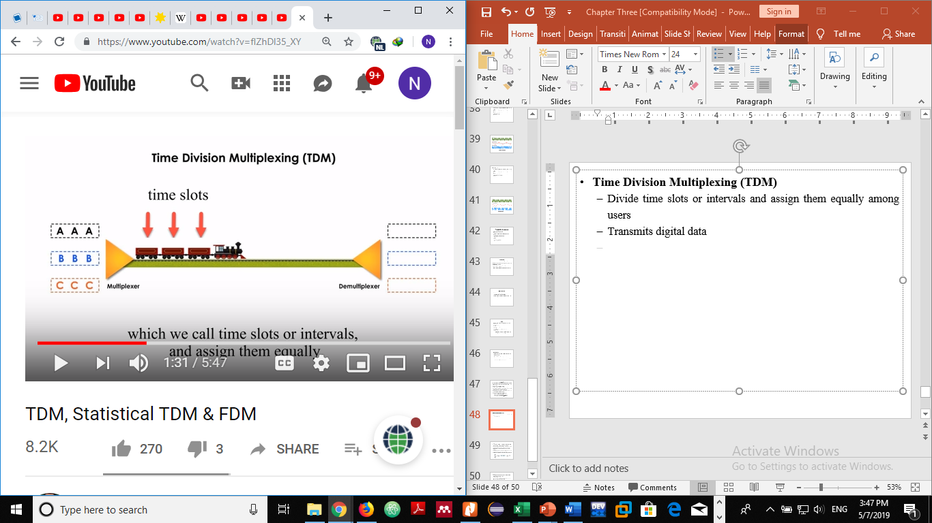
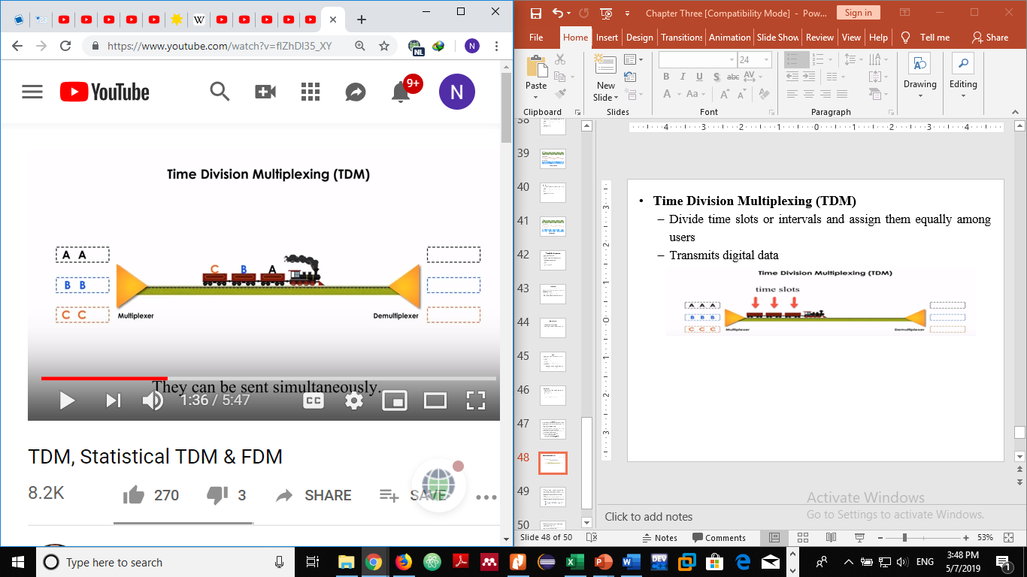
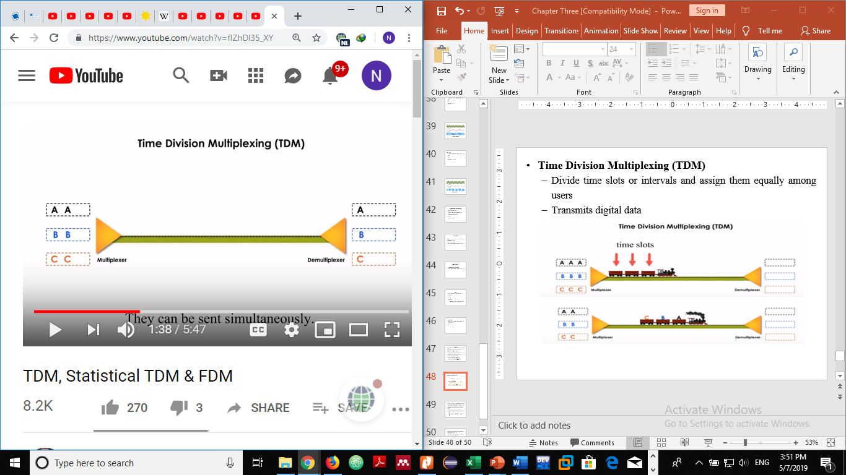

Slide 49
Advantages
  TDM systems are more flexible than frequency division multiplexing.
  circuitry is not complex.
  Problem of cross talk is not severe.
  Full available channel bandwidth can be utilized for each channel.
Disadvantages
  Synchronization is required in time division multiplexing.
  Complex to implement.
Applications
  It used in ISDN (Integrated Services Digital Network) telephone lines.
  It is used for some telephone system.
  It is used in cellular networks

Slide 50
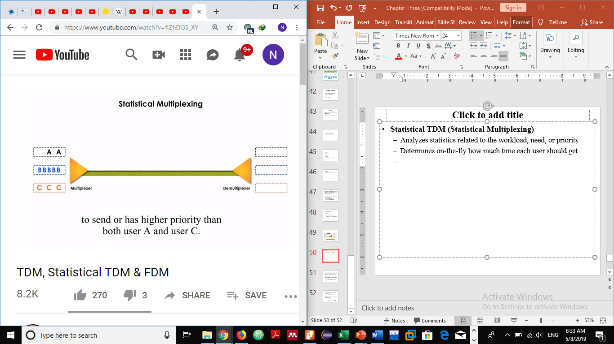
Statistical TDM (Statistical Multiplexing)
  Analyzes statistics related to the workload, need, or priority
  Determines on-the-fly how much time each user should get
  Compared with TDM, STDM is more efficient and more in control.
  The user B has more data than the others as shown in the figure above and hence it will get more priority and then user C.

Slide 51
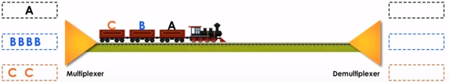
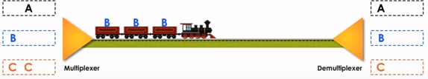
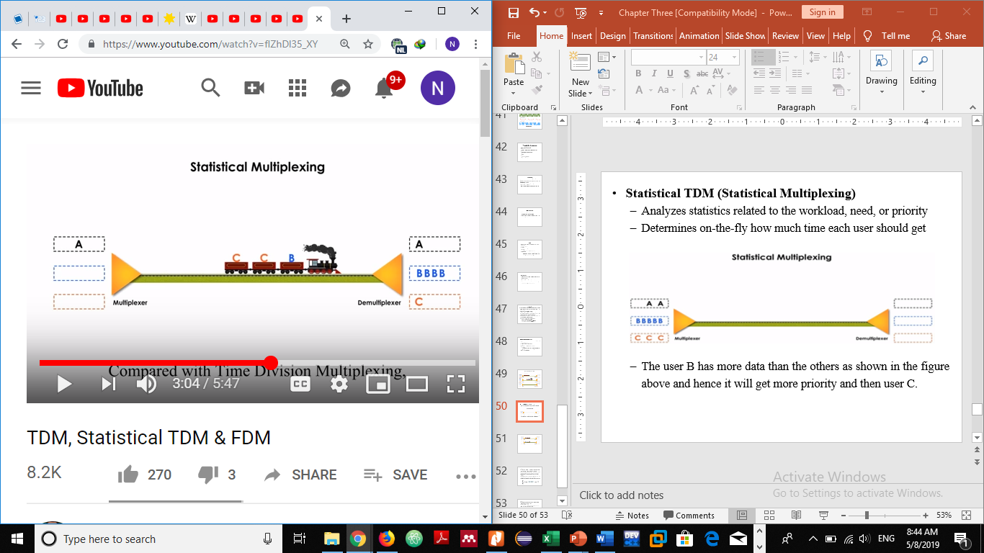

Slide 52
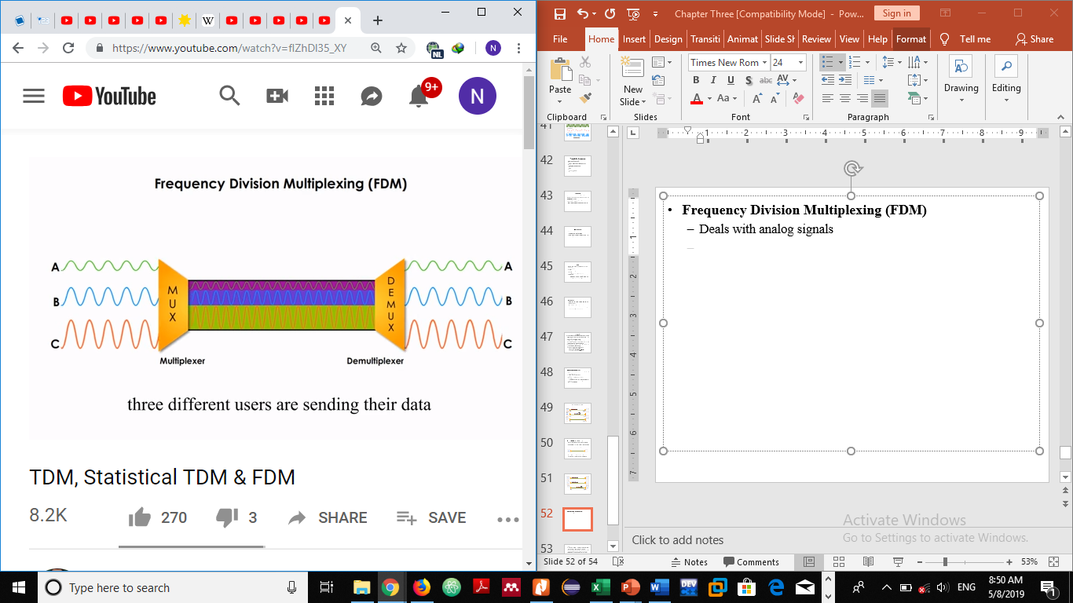
Frequency Division Multiplexing (FDM)
  Deals with analog signals
  Different users sends their data over the same channel
  FDM combines the signals and send them simultaneously
  each signal is modulated onto a different carrier frequency
  Signals travel in their own non-overlapping frequency sub-channels

Slide 53
Advantages
  It does not need synchronization between its transmitter and receiver.
  is simpler and easy demodulation.
  A large number of signals (channels) can be transmitted simultaneously.
Disadvantages
  It suffers problem of cross-talk.
  It is used only when a few low speed channels are desired.
  Intermodulation distortion takes place.
Applications
  It is used to public telephones and in cable TV systems.
  It is used in broad casting.
  It is used in AM and FM broadcasting.

